Slide 1

UNIVERSITÀ DEGLI STUDI DI MESSINA
DIPARTIMENTO DI INGEGNERIA
CORSO DI LAUREA TRIENNALE IN INGEGNERIA ELETTRONICA E INFORMATICA
Slow Feature Analysis
per Sistemi lineari e non lineari
Relatori:
Chiar.ma Prof.sa Maria Gabriella Xibilia
Chiar.mo Prof. Luca Patanè
Chiar.ma Dott.sa Francesca Sapuppo
Tesi di Laurea di:
Gabriele Rinaldi
A.A. 2022/2023

Slide 2
Indice
Metodi Data-Driven per l’identificazione dei modelli di sistemi dinamici
Metodi
Dynamic Mode Decomposition (DMD)
Dynamic Mode Decomposition with Control (DMDc)
Multi-Resolution
Casi di studio
Sulfur Recovery Unit (SRU)
Vehicle to Grid (V2G)
Risultati

Slide 3
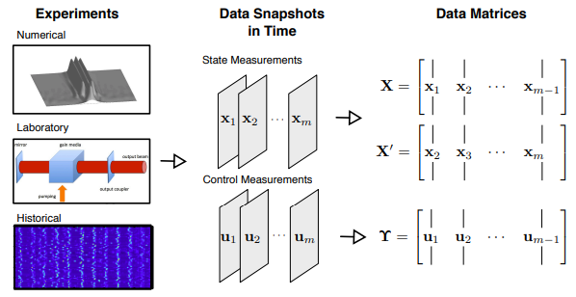
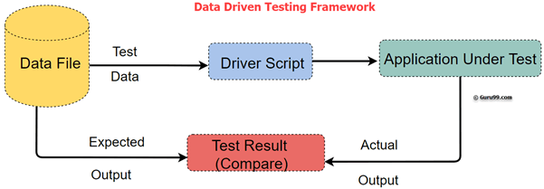

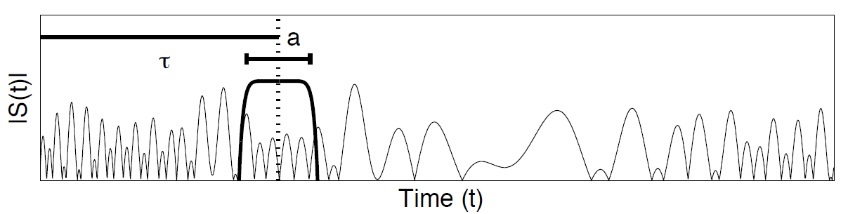
Metodi Data-Driven per l’identificazione di modelli di sistemi dinamici
Data-Driven Method Application
Model Predictive Control
Slow/Fast Feature
Tempo varianza

Slide 4
Metodi analizzati
Dynamic Mode Decomposition (DMD)
Dynamic Mode Decomposition with Control (DMDc)
Multi-Resolution Dynamic Mode Decompositon (mrDMD)
Multi-Resolution Dynamic Mode Decomposition with Control (mrDMDc)

Slide 5
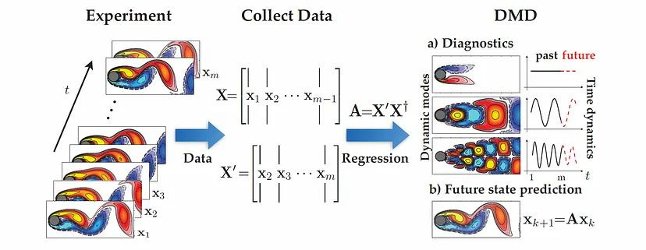
Dynamic Mode Decomposition

Slide 6
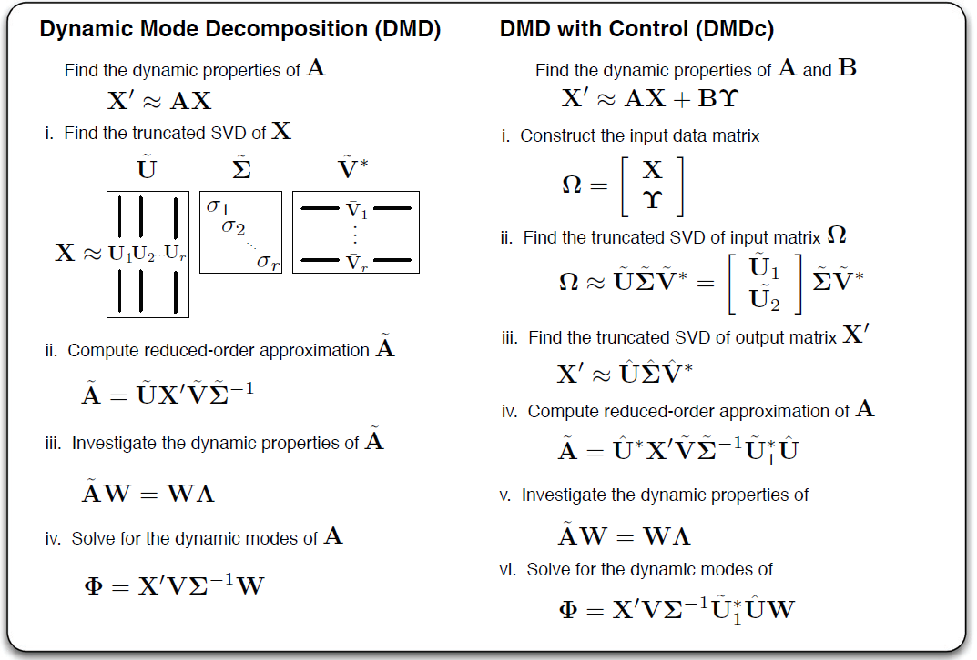
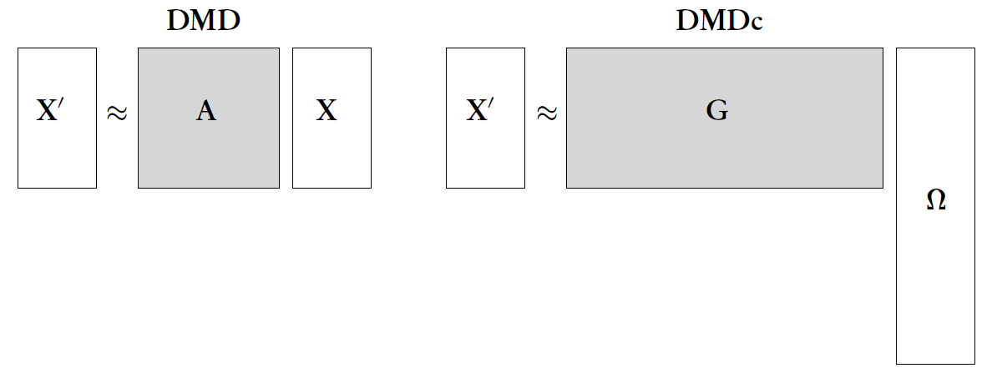
Dynamic Mode Decomposition with Control
Include l’analisi degli input rispetto al DMD

Slide 7
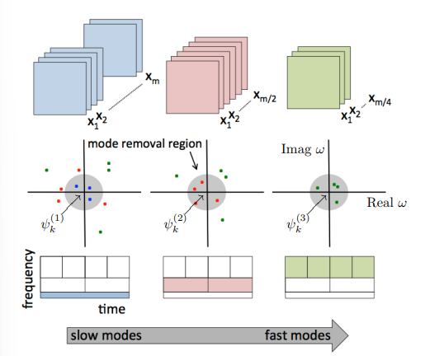
Multi-Resolution
Analisi su diverse scale temporali
Filtraggio dinamiche lente
Multi-Resolution Dynamic Mode Decomposition with Control
(mrDMDc)
Parametri da impostare:
SVD_rank (riduzione ordine del sistema identificato)
Slow_feature_scale (raggio delle dinamiche slow)
Max_cycles ( n.oscillazioni nell’intervallo di tempo)
Rimozione dinamiche lente dai dati sperimentali

Slide 8
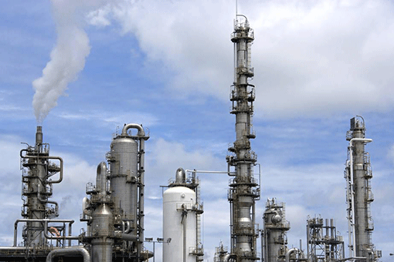
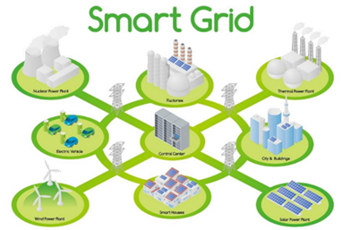
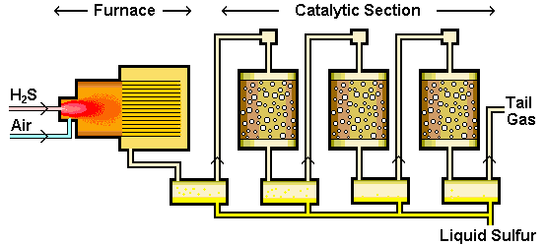
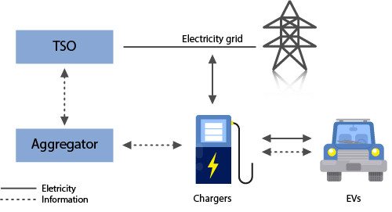
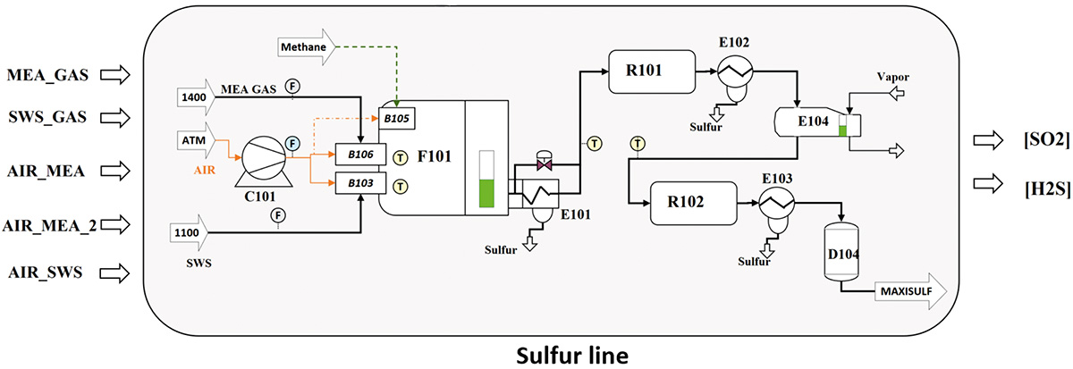
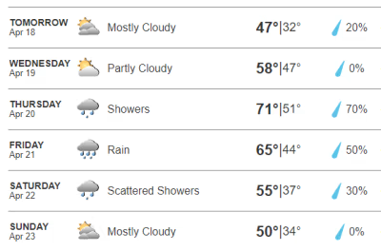
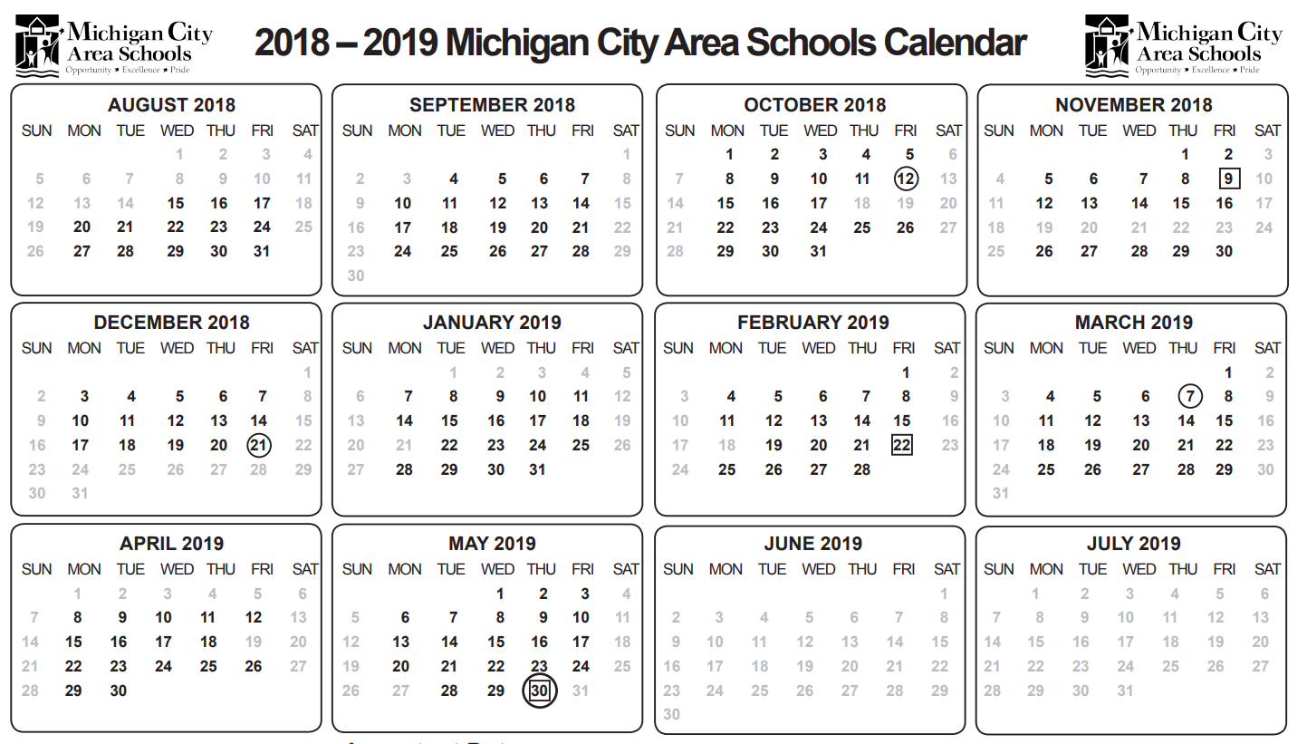
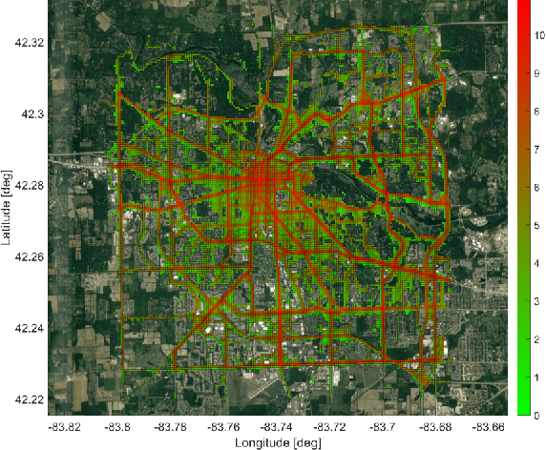
Casi di Studio
Sistema Sulfur Recovery Unit (SRU)
Sistema Vehicle to Grid (V2G)
Meteo
Festività
Aggregati
Modello Predittivo
Modello Predittivo
Soft-Sensors
EV Energy Storage
predizione di misurando che
“non può essere misurato” da sensori reali
Disponibilità a cedere energia alla rete
da Electric Vehicles

Slide 9
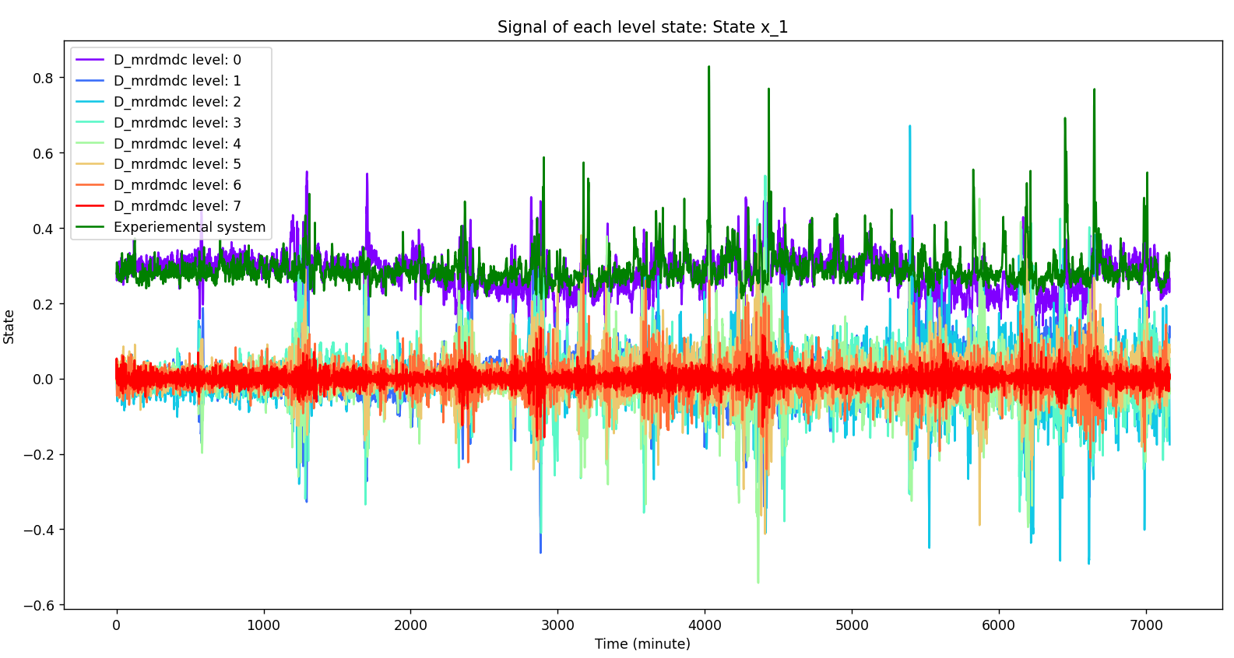
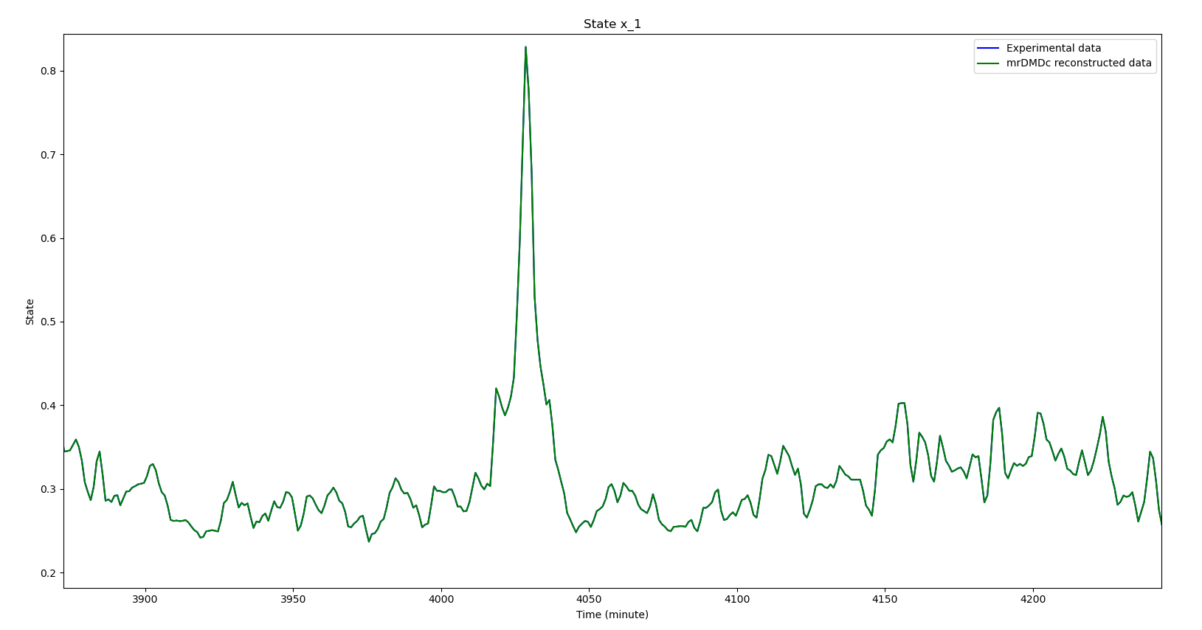
Modelli SRU: mrDMDc
Filtration level 0 | 13%
Filtration level 1 | 10%
Filtration level 2 | 10%
Filtration level 3 | 28%
Filtration level 4 | 29%
Filtration level 5 | 8%
Filtration level 6 | 30%
Filtration level 7 | 38%
Svd_rank | NO REDUCTION
Max_cycles | 10
Slow_feature_scale | 15
MSE | 8.18e-19
MAPE | 1.19e-09
MAE | 3.45e-10
RMSE | 9.04e-10
R^2 | 0.9999
Fast Dynamics
KPI
Parametri impostati
Ricostruzione
(Somma di tutti i livelli)
Decomposizione in livelli

Slide 10
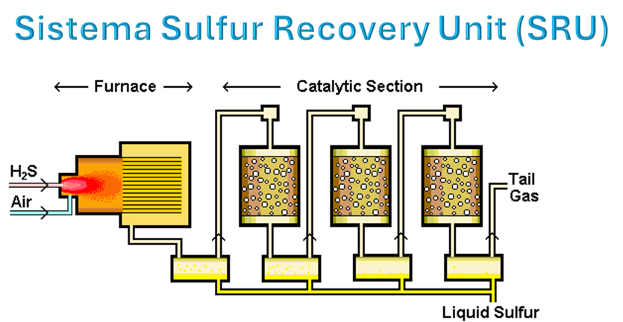
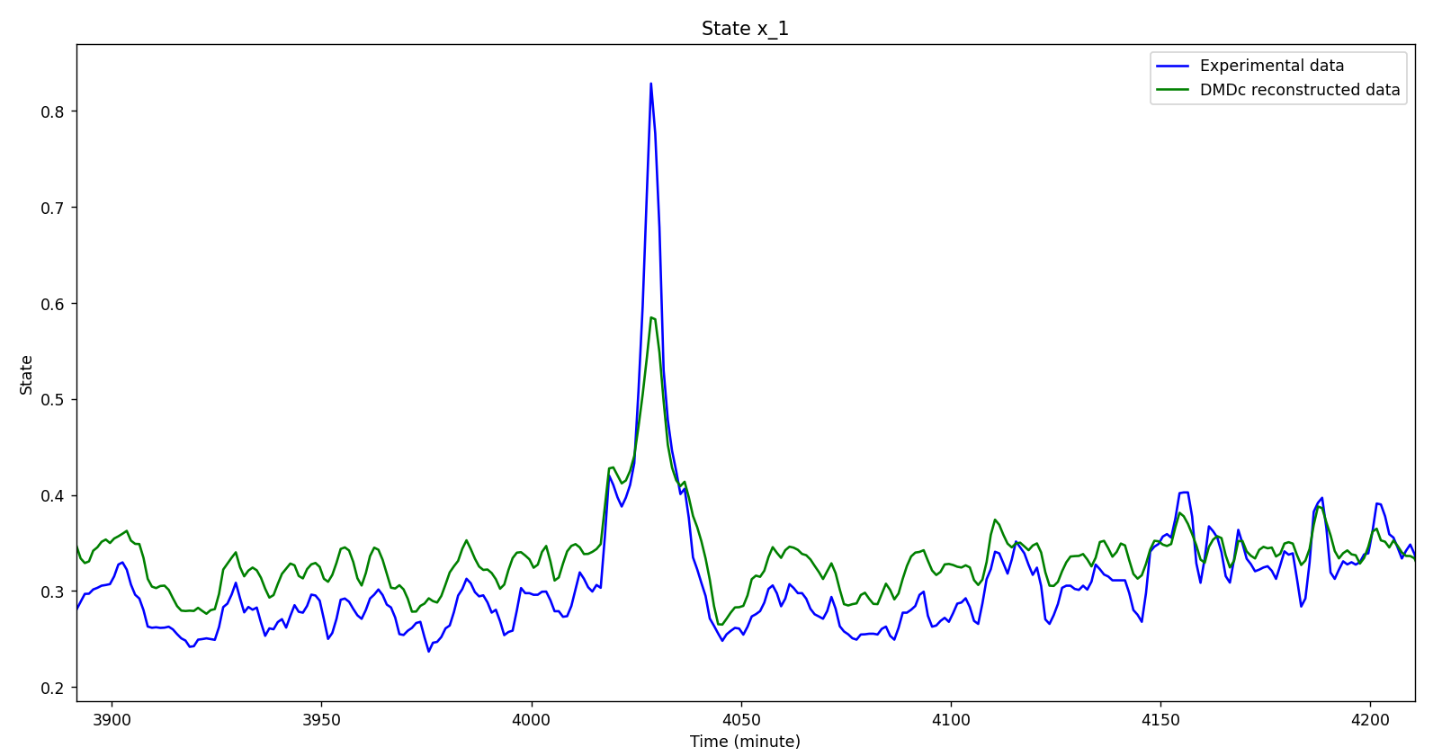
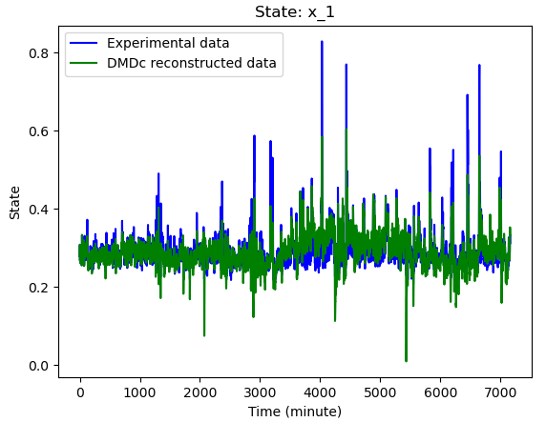
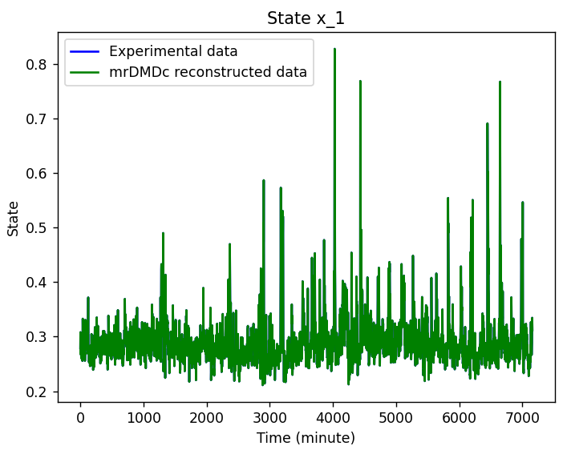
Modelli SRU: DMDc vs mrDMDc
DMDc
mrDMDc
Svd_rank | NO REDUCTION
Max_cycles | 10
Slow_feature_scale | 15
Parametri impostati
Svd_rank | NO REDUCTION
Parametri impostati
Filtration level 0 | 13%
Filtration level 1 | 10%
Filtration level 2 | 10%
Filtration level 3 | 28%
Filtration level 4 | 29%
Filtration level 5 | 8%
Filtration level 6 | 30%
Filtration level 7 | 38%
MSE | 6.95e-04
MAPE | 6.84e-02
MAE | 1.80e-02
RMSE | 2.64e-02
R^2 | 0.63
MSE | 8.18e-19
MAPE | 1.19e-09
MAE | 3.45e-10
RMSE | 9.04e-10
R^2 | 0.9999
KPI :
KPI :
Fast Dynamics

Slide 11
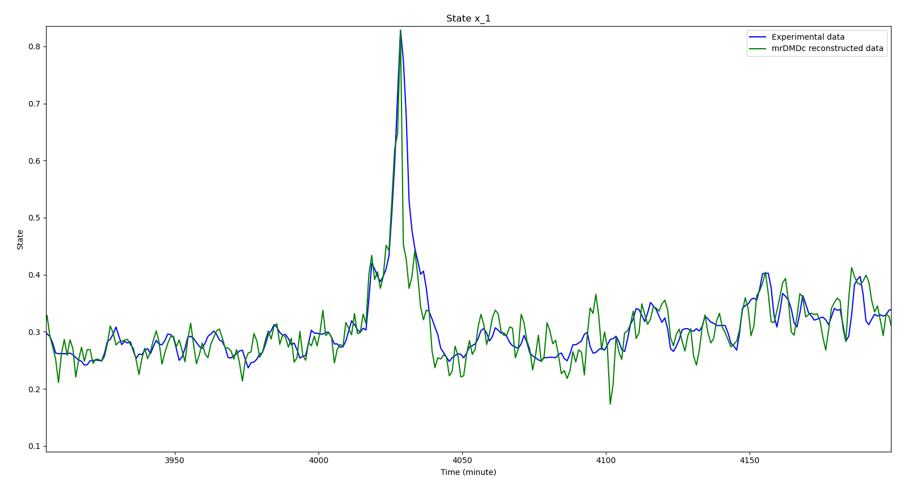
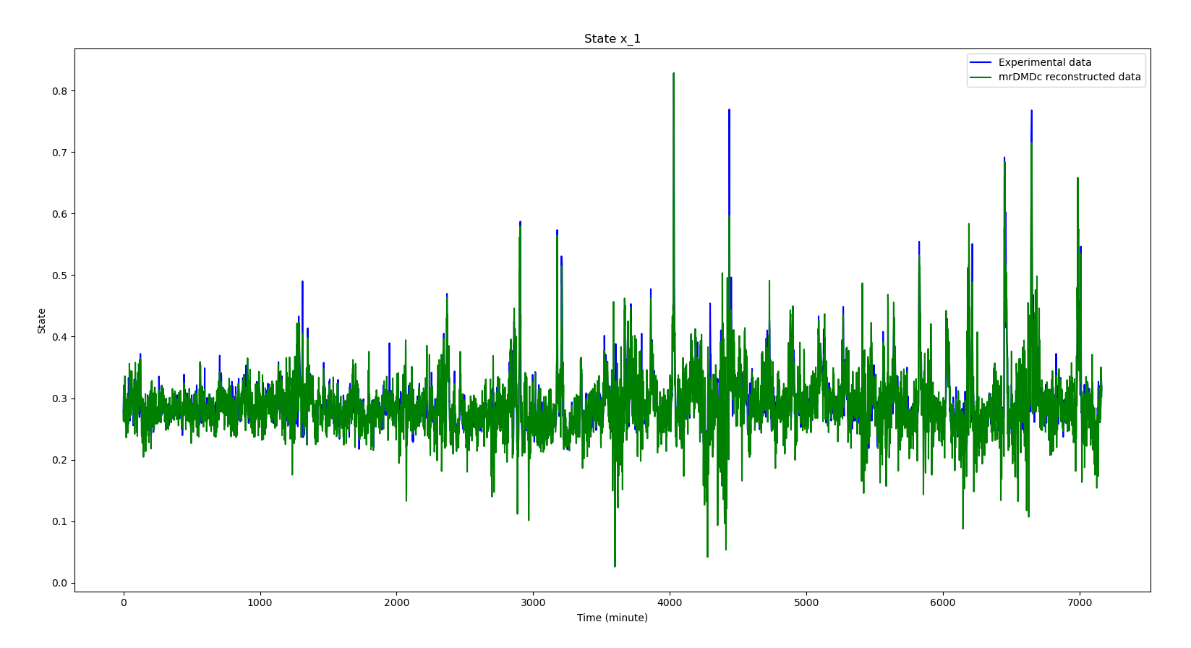
Modelli SRU: Studio parametrico su mrDMDc
mrDMDc
Parametri impostati
mrDMDc
Parametri impostati
Svd_rank | MODEL REDUCTION
Max_cycles | 10
Slow_feature_scale | 10
Svd_rank | NO REDUCTION
Max_cycles | 10
Slow_feature_scale | 15
Filtration level 0 | 10%
Filtration level 1 | 4%
Filtration level 2 | 5%
Filtration level 3 | 9%
Filtration level 4 | 10%
Filtration level 5 | 32%
Filtration level 6 | 97%
Filtration level 7 | 99%
Filtration level 0 | 13%
Filtration level 1 | 10%
Filtration level 2 | 10%
Filtration level 3 | 28%
Filtration level 4 | 29%
Filtration level 5 | 8%
Filtration level 6 | 30%
Filtration level 7 | 38%
MSE | 4.59e-04
MAPE | 0.13
MAE | 1.43e-02
RMSE | 2.14e-02
R^2 | 0.79
MSE | 8.18e-19
MAPE | 1.19e-09
MAE | 3.45e-10
RMSE | 9.04e-10
R^2 | 0.9999
KPI
Fast Dynamics
KPI
Fast Dynamics

Slide 12
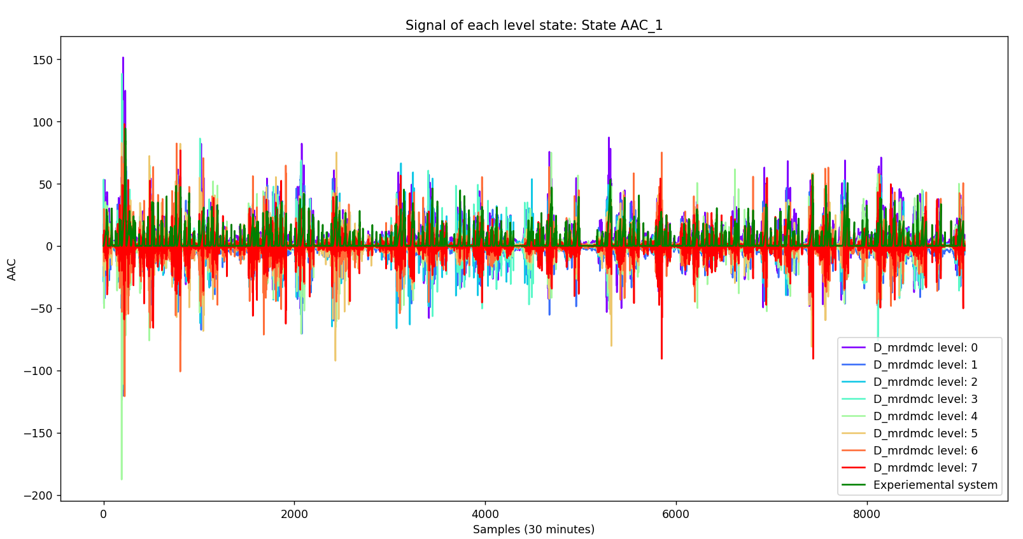
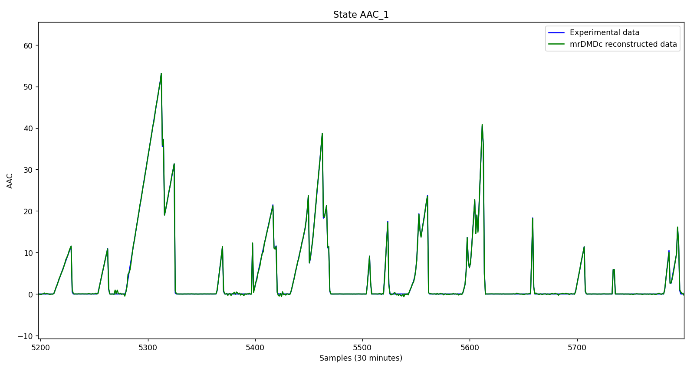
Modelli V2G: mrDMDc
Filtration level 0 | 40%
Filtration level 1 | 27%
Filtration level 2 | 40%
Filtration level 3 | 39%
Filtration level 4 | 39%
Filtration level 5 | 38%
Filtration level 6 | 44%
Filtration level 7 | 61%
Svd_rank | NO REDUCTION
Max_cycles | 10
Slow_feature_scale | 5
MSE | 0.32
MAPE | 0.68
MAE | 0.17
RMSE | 0.57
R^2 | 0.99
Fast Dynamics
KPI
Parametri impostati
Ricostruzione
(Somma di tutti i livelli)
Decomposizione in livelli

Slide 13
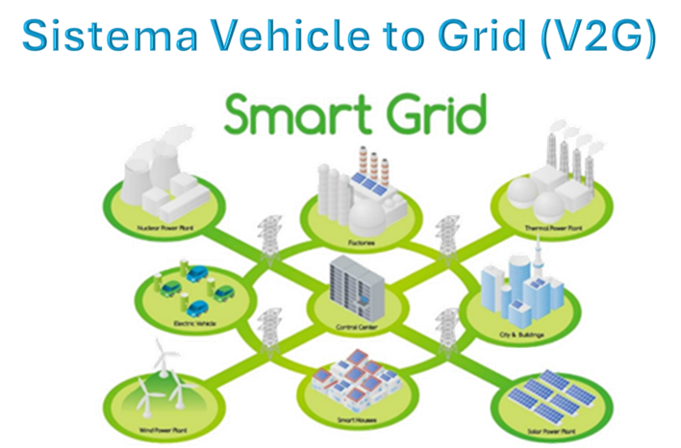
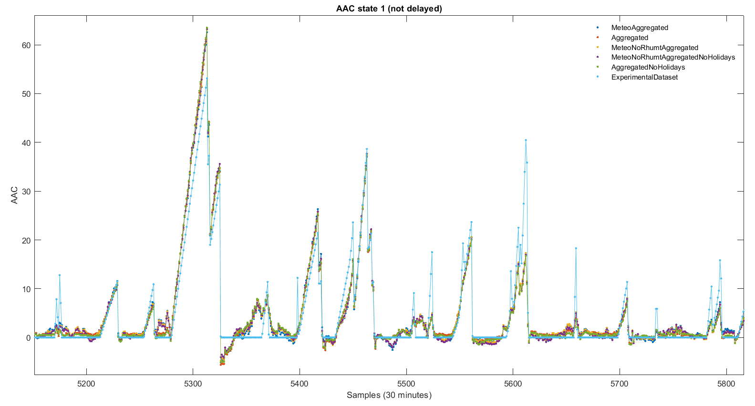
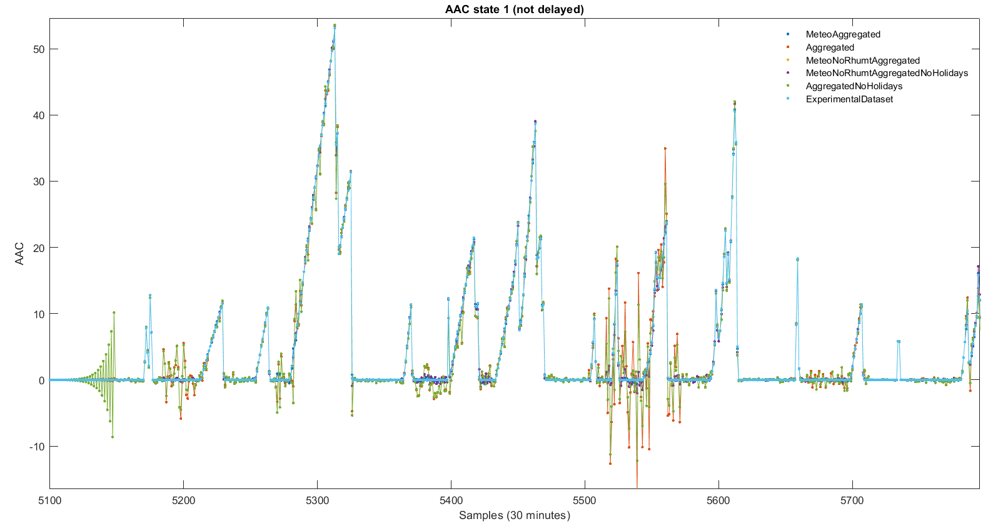
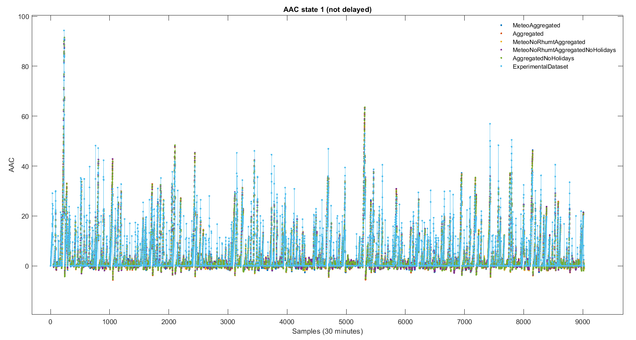
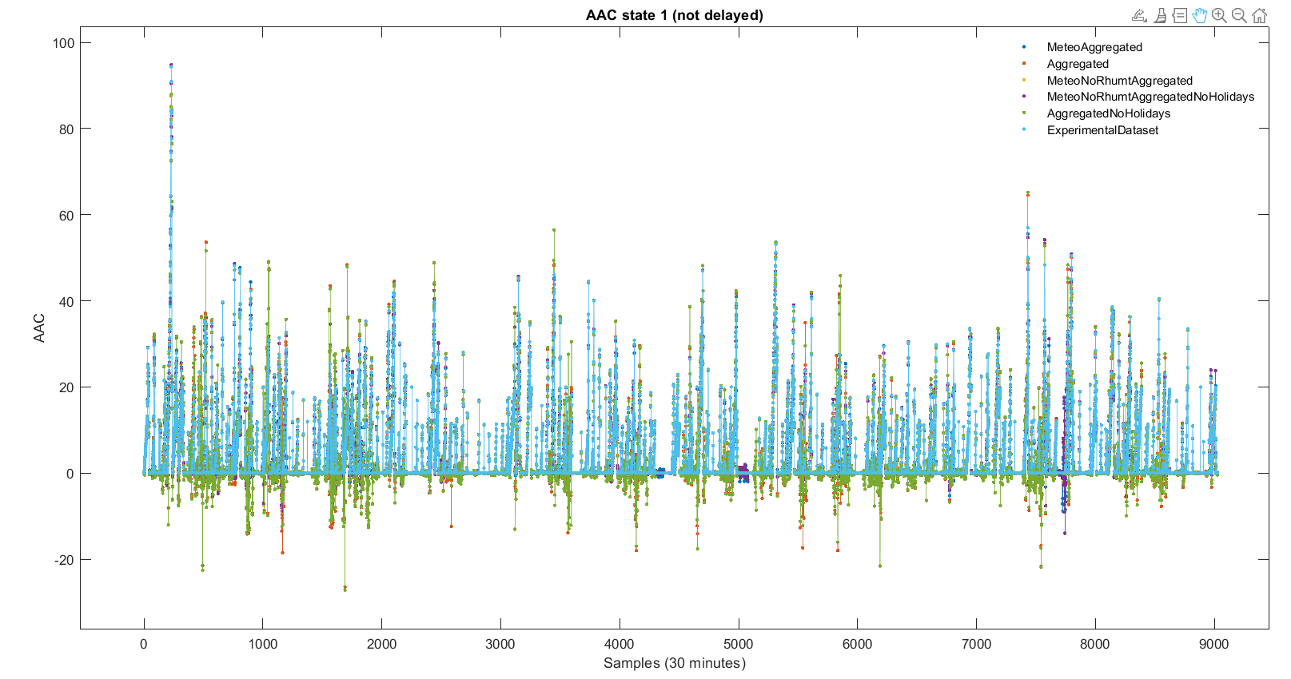
Modelli del V2G: DMDc vs mrDMDc
DMDc
mrDMDc
Svd_rank | -1
Max_cycles | 10
Slow_feature_scale | 5
Parametri impostati
Parametri impostati
Svd_rank | -1
Filtration level 0 | 40%
Filtration level 1 | 27%
Filtration level 2 | 40%
Filtration level 3 | 39%
Filtration level 4 | 39%
Filtration level 5 | 38%
Filtration level 6 | 44%
Filtration level 7 | 61%
MSE | 9.10
MAPE | 1.88
MAE | 1.74
RMSE | 3.02
R^2 | 0.85
MSE | 0.32
MAPE | 0.68
MAE | 0.17
RMSE | 0.57
R^2 | 0.99
Fast Dynamics
KPI
KPI

Slide 14
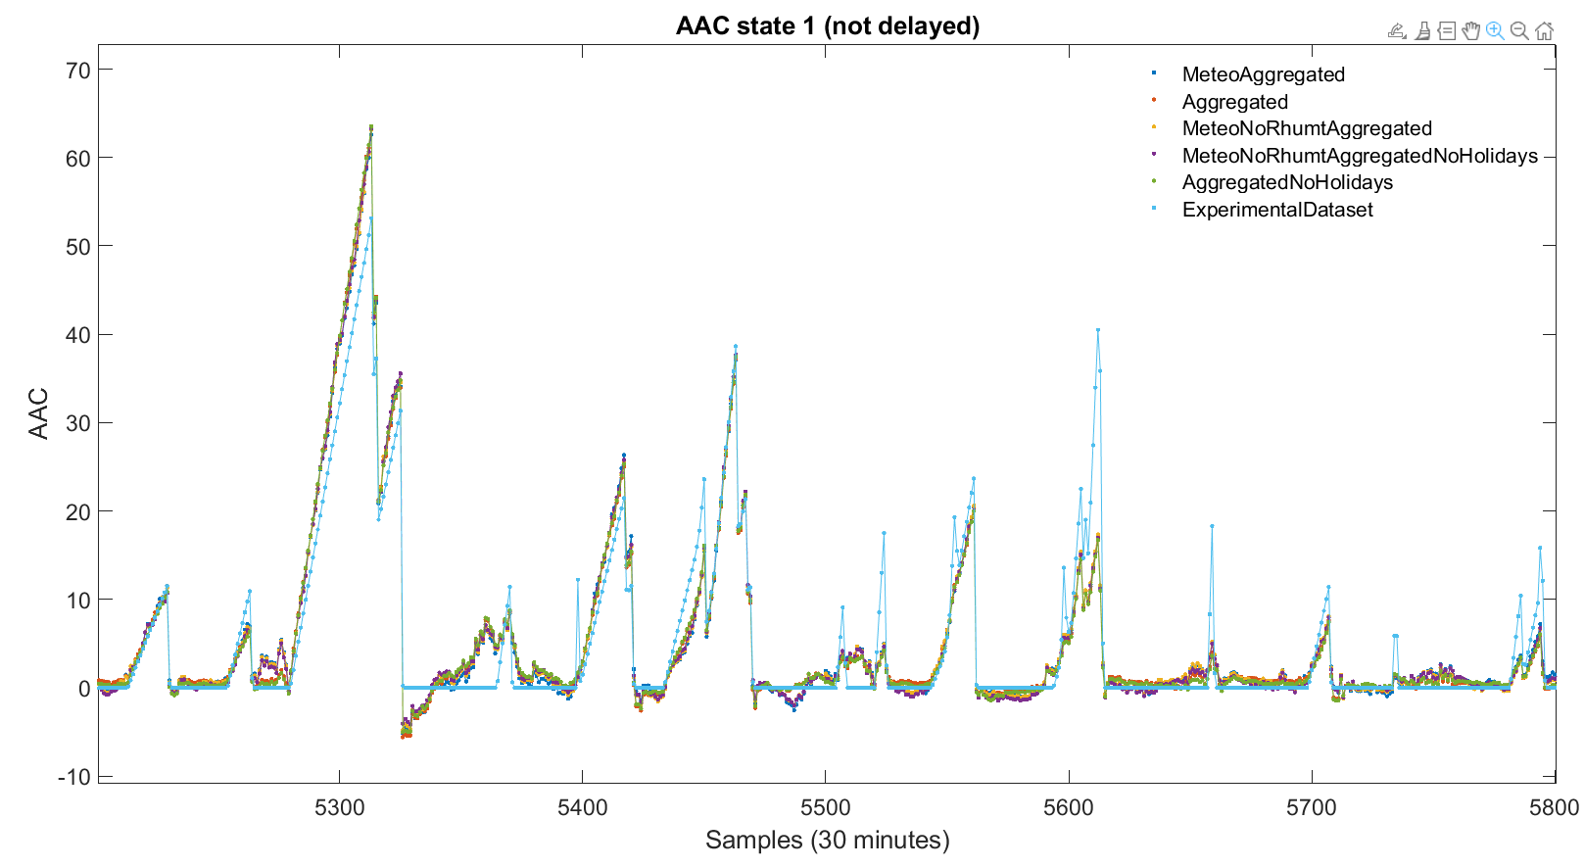
Modelli V2G: DMDc al variare dei dati in ingresso
Parametri impostati:
Svd_rank | -1
Meteo (no rhum_t) + Aggregated (no holidays):
Meteo (no rhum_t) + Aggregated:
Aggregated (no holidays):
Meteo + Aggregated:
Aggregated:
MSE | 9.10
MAPE | 1.88
MAE | 1.74
RMSE | 3.02
R^2 | 0.85
MSE | 9.63
MAPE | 0.97
MAE | 1.70
RMSE | 3.10
R^2 | 0.84
MSE | 9.20
MAPE | 1.09
MAE | 1.73
RMSE | 3.03
R^2 | 0.85
MSE | 9.27
MAPE | 1.16
MAE | 1.72
RMSE | 3.04
R^2 | 0.85
MSE | 9.70
MAPE | 0.99
MAE | 1.69
RMSE | 3.11
R^2 | 0.84
KPI
KPI
KPI
KPI
KPI

Slide 15
Conclusioni e Sviluppi futuri
Conclusioni
Analisi delle prestazioni dei metodi mrDMDc e DMDc su casi di studio reali non Lineari
Ottimizzazione computazionale tramite troncamento e filtraggio per mrDMDc
Sviluppi futuri
Applicazione della tecnica mrDMDc per la predizione multi-step-ahead

Slide 16
Grazie per l’attenzione

